Slide 1
Information Assignment 2

Slide 2
Relation Schema: It refers to the blueprint or structure that defines the logical organization of data in a relational database. It includes the names of the attributes (columns), their data types, and any constraints or rules that apply to the data. For example, the many different tables in the database and how they relate
Relation: A single table within a schema. For example, the class room table
Instance: An instance refers to the actual data stored in a database at a specific point in time. It represents the rows or records within a table that contain actual values. An instance is essentially a snapshot of the database's contents at a given moment, reflecting the real-world data being managed by the system. For example, the individual value room number

Slide 3
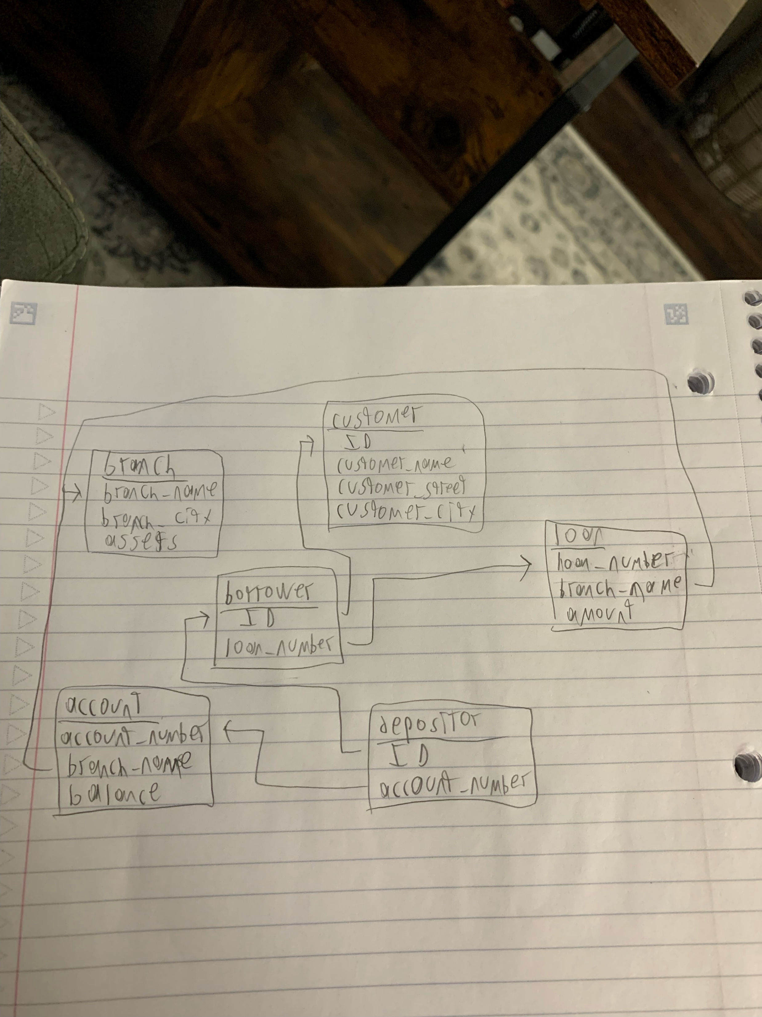

Slide 4
1. Branch_name, ID, loan_number, account_number
2. account_number, branch_name, loan_number

